Slide 1
Identificator in MIM-UML
Verkenning dmv een use case

Slide 2
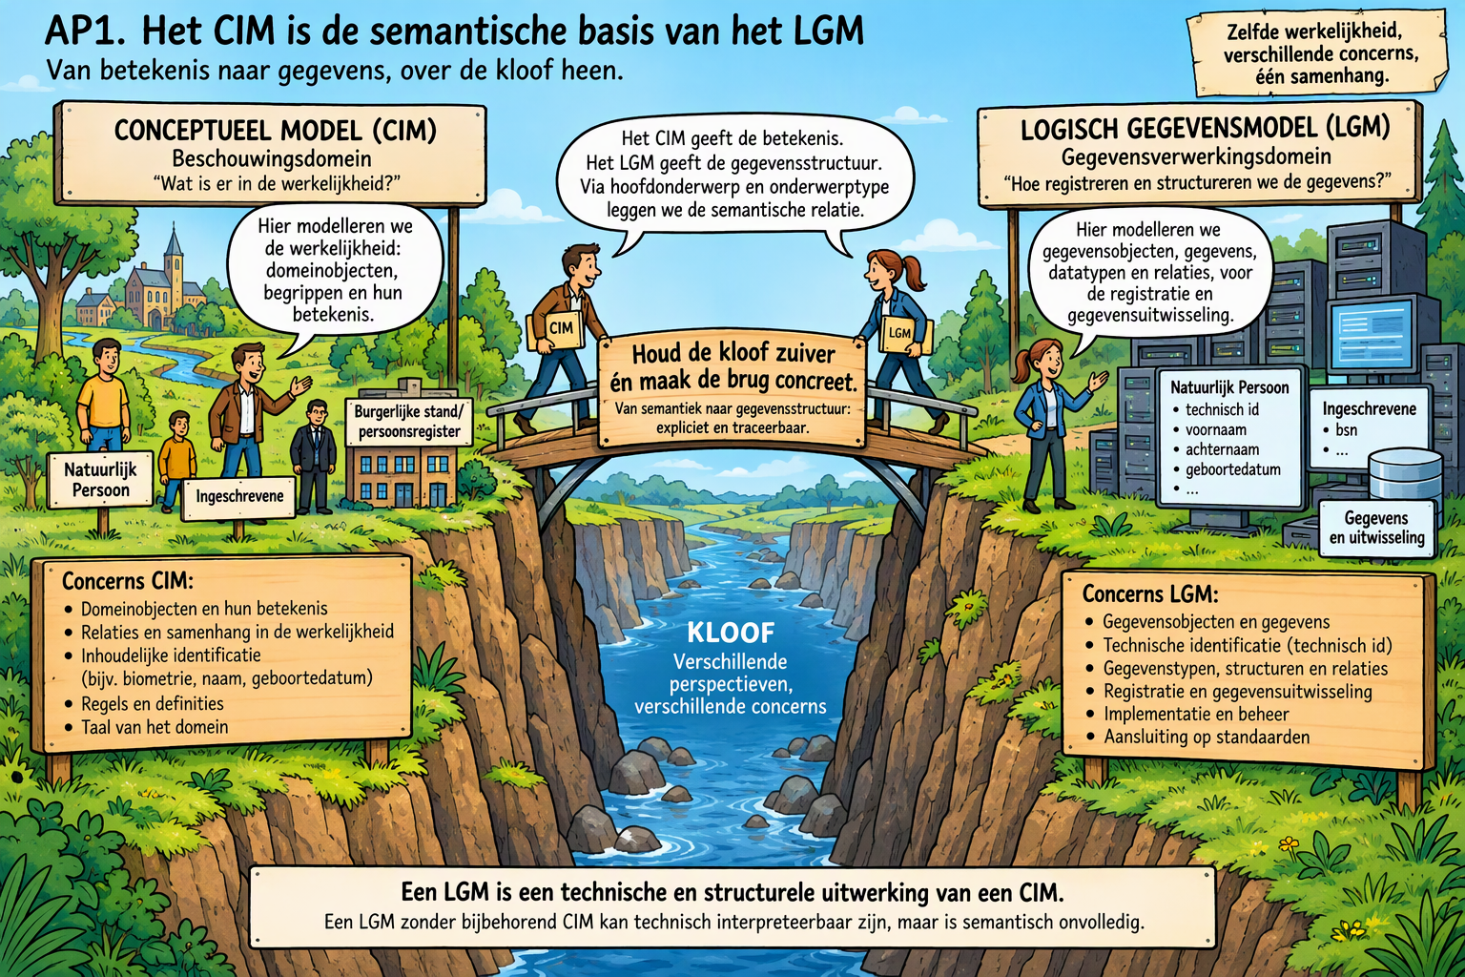
The Canyon of Separation of Concerns
The River of Separation
The Bridge of Connection

Slide 3
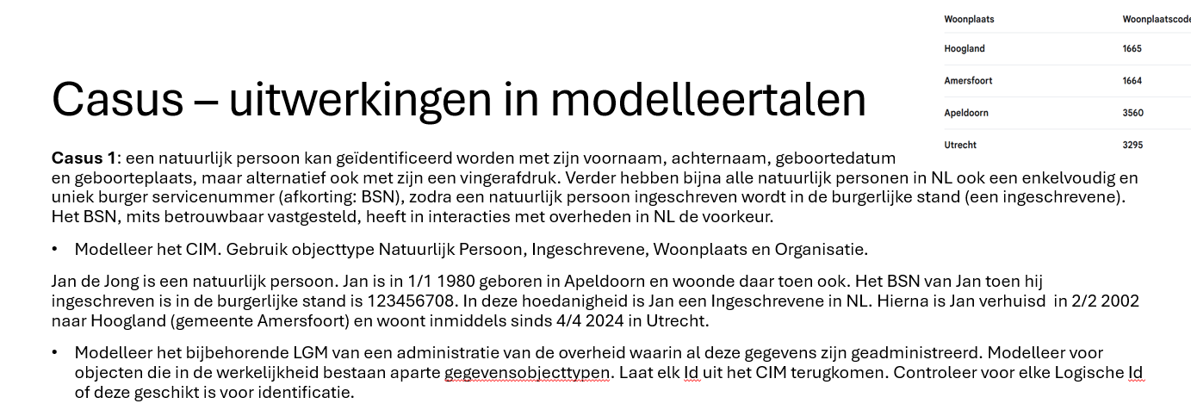
De use case

Slide 4


Slide 5
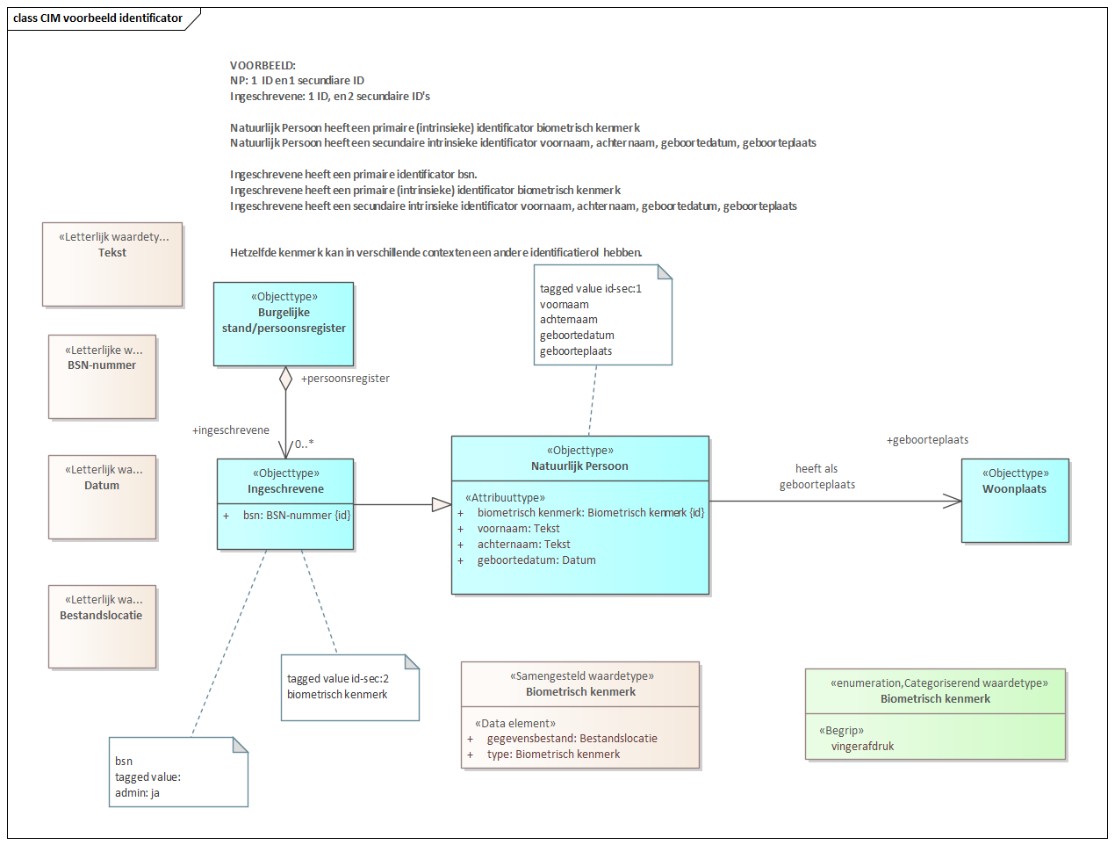

Slide 6
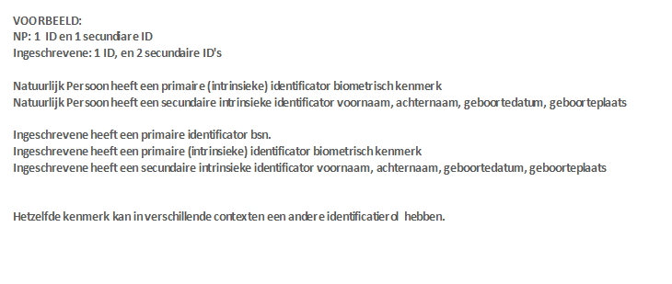

Slide 7
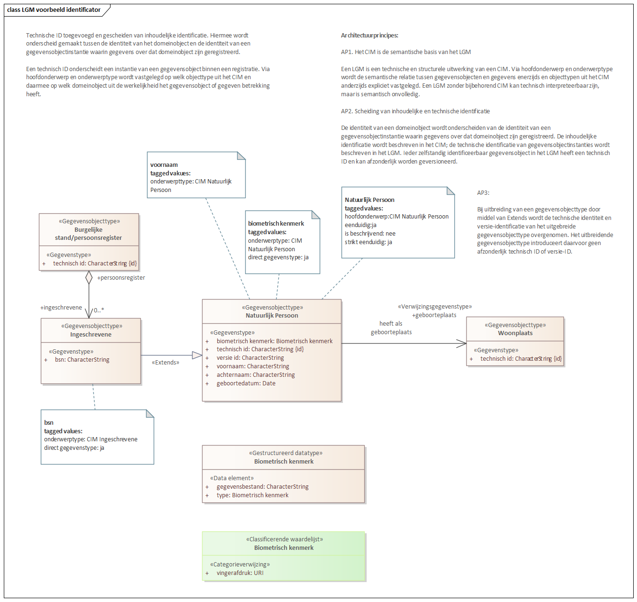

Slide 8


